Slide 1

College of Technology
Silver Oak College of Engineering and Technology
Bachelor of Technology
Department of Information Technology
Shopper
Group Members Detail
Dolly Agrawal - 2101031000003
Internal Guide Detail
Prof. Purvi Patel

Slide 2
Table of Content
Abstract
Introduction
Literature Survey/Research
Study of Current System
Improvement needed in Current System
Features of Proposed System
Object Oriented Diagrams (Flow Chart)
Wireframe
Tools and Technologies used
Worked carried out till date
Timeline Chart(Gantt chart)
Future Work
Conclusion
References

Slide 3
Abstract
The e-commerce website "Shopper" is developed using the MERN stack, focused on selling clothes for men, women, and kids. The website integrates user authentication through JWT tokens and offers a streamlined checkout process using Stripe payment. With a robust UI and categorized product listings, the project aims to offer a seamless and secure online shopping experience.

Slide 4
Introduction
The "Shopper" website provides a platform for users to purchase clothes categorized into men, women, and kids sections. Built using the MERN stack, it emphasizes user authentication and online payment integration. The goal is to enhance the customer’s online shopping experience by providing a well-structured, secure, and easy-to-navigate website.

Slide 5
Literature Survey/Research
E-commerce Trends: Studying various online shopping platforms such as Amazon, Flipkart to understand the market, features, and user experience.
Security: Research on the best practices for integrating JWT tokens for authentication and Stripe for secure payment processing.
User Experience: A comparative study on user-friendly UI designs, mobile responsiveness, and efficient categorization of products.
Technology Stack: Exploration of the MERN stack (MongoDB, Express.js, React.js, Node.js) for full-stack web development.

Slide 6
Study of Current System
The current systems in the e-commerce sector generally follow a well-established structure, providing secure payment, user authentication, and product listings with detailed descriptions. However, there are limitations, particularly in smaller websites, regarding performance optimization, user-friendly UI, and security vulnerabilities.

Slide 7
Improvements Needed in Current System
Faster loading times, a more responsive design, easier checkout flow, better integration of secure payment gateways like Stripe, and an efficient system for managing product categories and cart data.

Slide 8
Features of Proposed System
User Authentication: JWT token-based user login and registration.
Product Categorization: Separate sections for men, women, and kids.
Secure Payments: Stripe integration for seamless and secure transactions.
Full Product Descriptions: Each product has a detailed description view, aiding user decision-making.

Slide 9
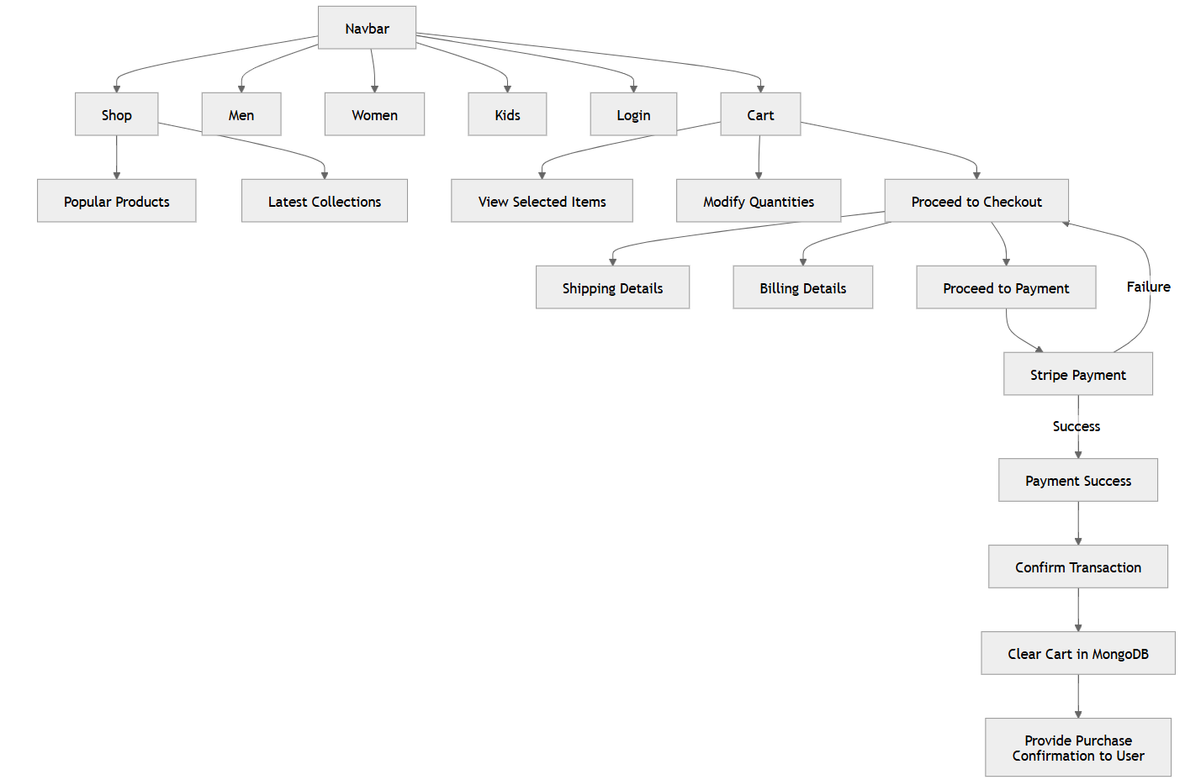
Object Oriented Diagrams (Flow Diagram)

Slide 10
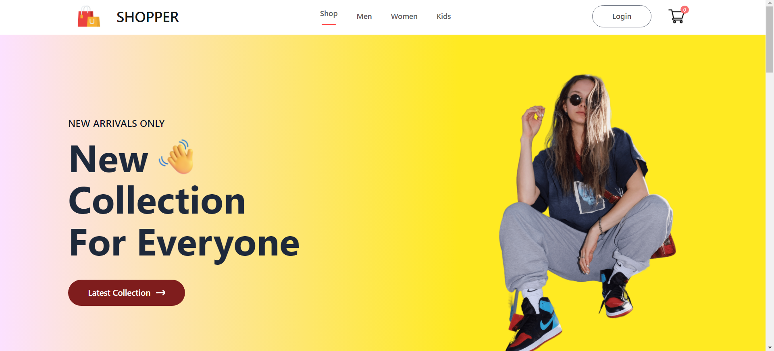
Wireframe

Slide 11
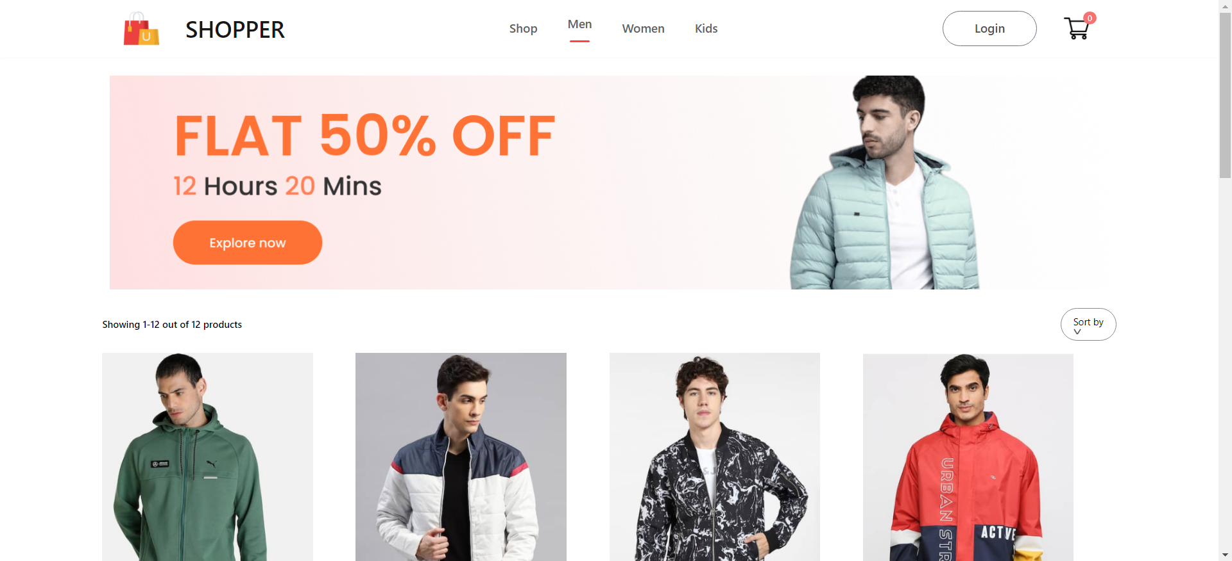
Wireframe

Slide 12
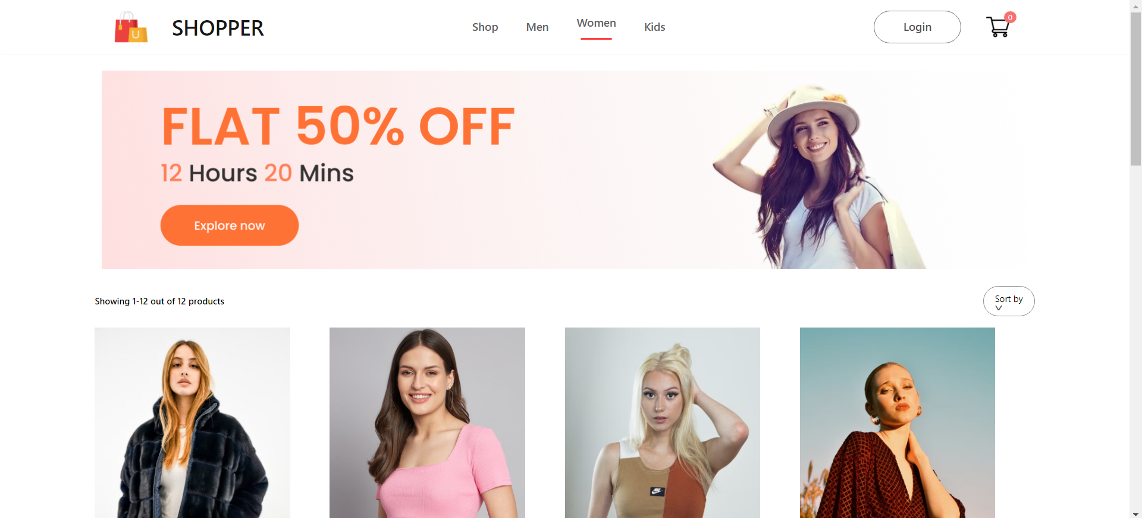
Wireframe

Slide 13
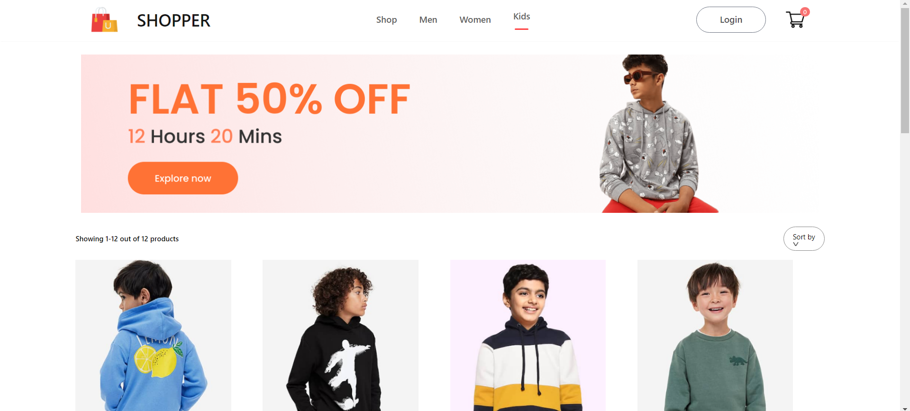
Wireframe

Slide 14
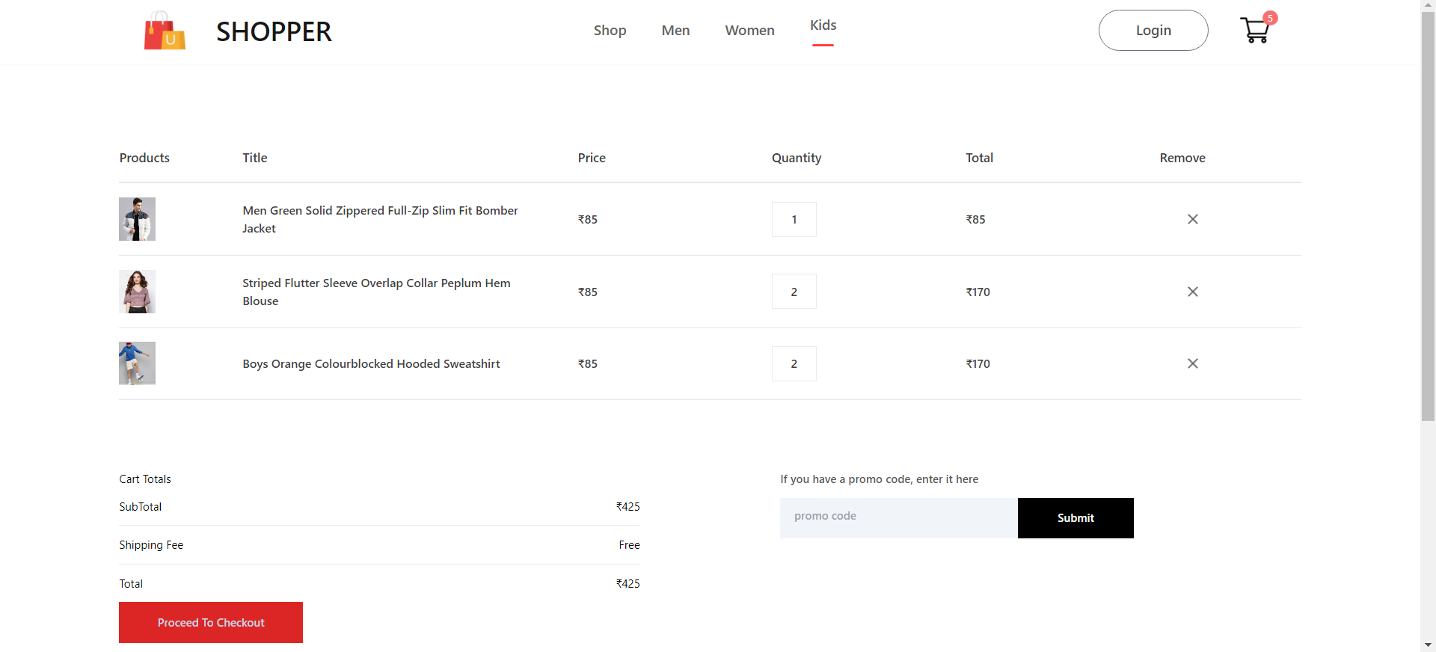
Wireframe

Slide 15
Tools & Technologies used
Frontend: React.js for dynamic and responsive UI.
Backend: Node.js and Express.js for handling API calls and managing business logic.
Database: MongoDB for storing product and user data.
Authentication: JWT for secure user authentication.
Payment Gateway: Stripe for secure online payment processing.
Version Control: GitHub for code management.

Slide 16
Worked carried out till date
Completed product listing pages for men, women, and kids.
Implemented JWT token-based user authentication.
Integrated Stripe for payment processing.
Developed full product description views and added a cart system.
Set up the database in MongoDB, storing product and user details.

Slide 17
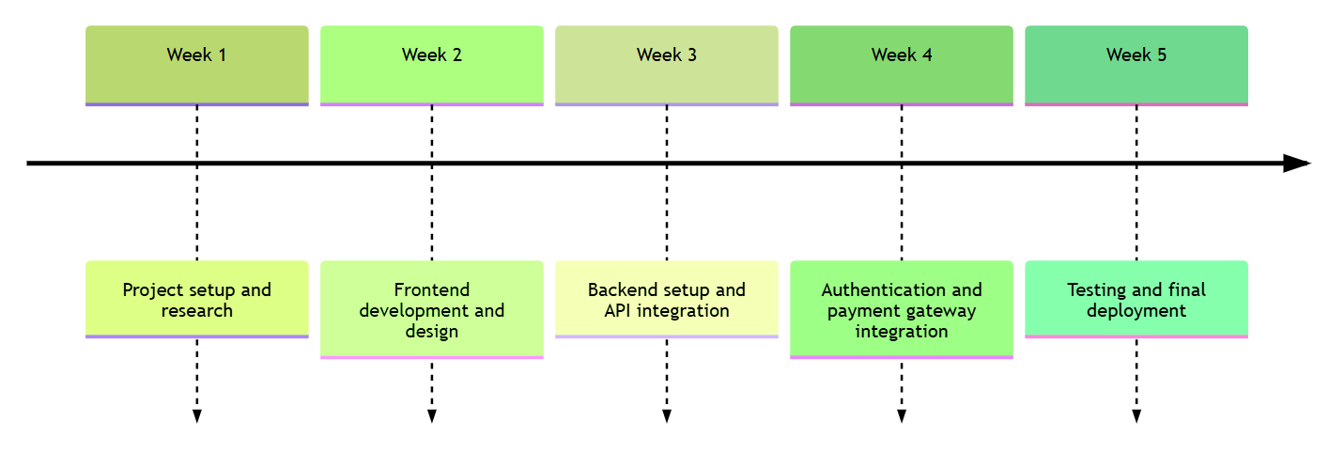
Timeline Chart (Gantt chart)

Slide 18
Future Work & Conclusion
Implement personalized product recommendations.
Enhance product search capabilities with advanced filtering options.
Making Website responsive for mobile devices.
Improve the admin dashboard for easier product and order management.
The "Shopper" project provides an efficient and secure platform for online shopping. By utilizing the MERN stack, JWT authentication, and Stripe integration, it aims to provide users with a smooth and secure shopping experience, focusing on ease of use, performance, and security.

Slide 19
References
MERN stack documentation.
JWT Token implementation resources.
Stripe API documentation.
Research papers on e-commerce security and trends.

Slide 20
Thank You..!
Any Questions?

